Slide 1
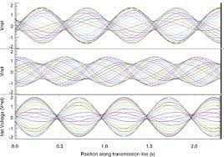
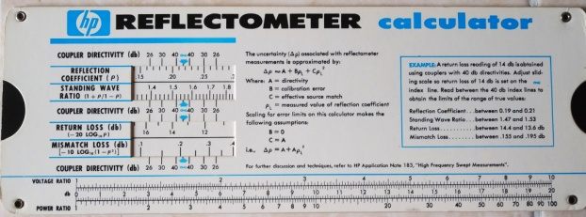
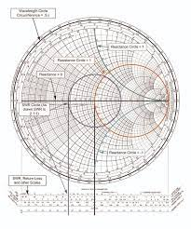
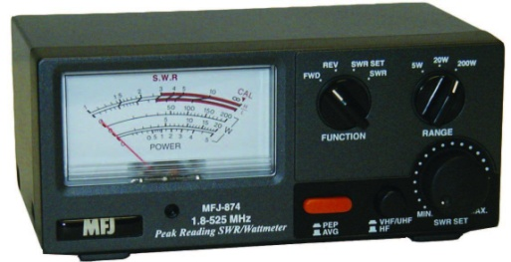
VSWR: Meaning Mathematical Interpretation &
Misconceptions
Mark Hoffman
KC3BNV

Slide 2
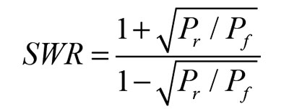
The 3 M’s of VSWR
The goal of this presentation is to:
- Describe the phenomena of Standing Waves
- Explain the meaning of SWR from a Physics & Engineering Point of View
- Discuss some of the misconceptions surrounding SWR in the Ham Community

Slide 3
The 3 M’s of VSWR
SWR (Standing Wave Ratio) is actually an abbreviated form of VSWR (Voltage Standing Wave Ratio). These terms are interchangeable.
Not only can you talk about voltage waves, but current waves, and power waves, as well.

Slide 4
The 3 M’s of VSWR
Some authors try to explain the concept of wave phenomena and wave interactions, by using the analogy of spherical water waves on the surface of a pond.

Slide 5
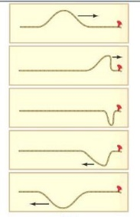
The 3 M’s of VSWR
A better approach to the understanding of actual transverse traveling waves, wave reflections, and the generation of standing waves.
Consider a chord under tension, tied to a barrier at its opposite end.
Now suppose a transverse mechanical wave (pulse) is launched from the far left-hand end of the chord.
The wave will travel down the chord and will be reflected at the barrier, and return, 180° out of phase.

Slide 6
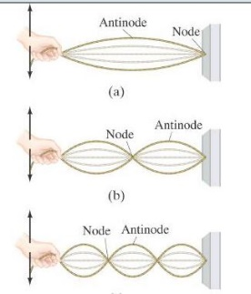
The 3 M’s of VSWR
Imagine, while the reflected pulse returns, it interacts with more pulses launched from the left side, a steady stream of pulses, at a specific rate.
Now, if the frequency of the pulses is just right, the incident and reflected pulses will interfere with each other in such a way that a large amplitude “standing wave” will be produced.
It I called a standing wave because it appears to be standing still (not traveling)
Points of complete destructive interference are called “nodes”, and the points of complete constructive interference are called “anti-nodes”

Slide 7
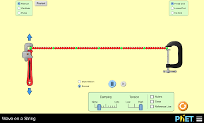
The 3 M’s of VSWR
https://phet.colorado.edu/sims/html/wave-on-a-string/latest/wave-on-a-string_en.html
This is a link to a simulation from the University of Colorado PhET Dept

Slide 8
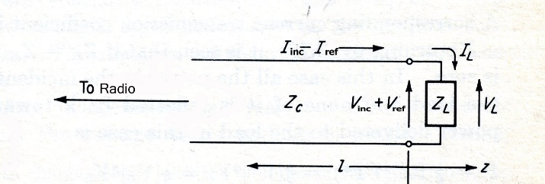
The 3 M’s of VSWR
Consider RF waves on a transmission line:
This transmission line has a characteristic impedance Zc (like a coaxial feedline) and is terminated with a load impedance ZL (like an antenna) with a voltage wave, and its associated current, incident on the load.

Slide 9
The 3 M’s of VSWR
All interfaces, including all connections
and devices in the line, are places where
RF waves (and the energy in the waves)
can be partially ( or completely) reflected,
resulting in standing waves!
Some of the voltage wave will be reflected back toward the radio. The composite voltage wave at the load will then consist of Vinc + Vref .
The ratio of the incident voltage to the reflected voltage is called the reflection coefficient ρ. (some texts use Γ– gamma as the reflection coefficient)
ρ$= \frac{V_{ref}}{V_{inc}}$

Slide 10
The 3 M’s of VSWR
ρ$= \frac{V_{ref}}{V_{inc}}$, and $\frac{Z_{L}}{Z_{C}}=\frac{1+ρ}{1−ρ}$ (1)
Solving for ρ , we get
ρ$=\frac{Z_{L}−Z_{c}}{Z_{L}+Z_{C}}$ $=\frac{{\overline{Z}}_{L}−1}{\overline{Z_{L}}+1}$ (2) ${\overline{Z}}_{L}=normalized load impedance= \frac{Z_{L}}{Z_{C}}$
The important result is that the reflection coefficient is solely a function of the load impedance and can vary from 0 to +/- 1 (0 – no reflection, 1 – total reflection)

Slide 11
The 3 M’s of VSWR
The load is said to be “matched” to the transmission line when Γ = 0. If the load impedance does not equal the characteristic line impedance, the load is considered to be “mismatched” to the line, and standing waves produced.
Therefore we can define the voltage standing ratio as:
$VSWR=\frac{1+ρ}{1−ρ}$ (3)
Given that voltage goes as the square root of the power, equation (3) can be redefined in terms of equation (1) to yield the familiar equation shown above.

Slide 12
The 3 M’s of VSWR
Now, instead of defining the reflection coefficient only at the load, imagine extending that definition to any point along the transmission line!!!
So that the reflection coefficient is also traveling using the same wave information (called the wave phaser for you engineering types) as the voltage incident and reflected waves.
This changes the notion of a standing wave (which is a composite wave of Vinc + Vref from a static quantity traveling quantity.
The concept of a static standing wave is a common misconception and is only true when ρ is +/- 1.
In reality the Composite Standing Wave (Vinc + Vref) is a traveling wave with the same wave phaser as the incident and reflected wave.

Slide 13
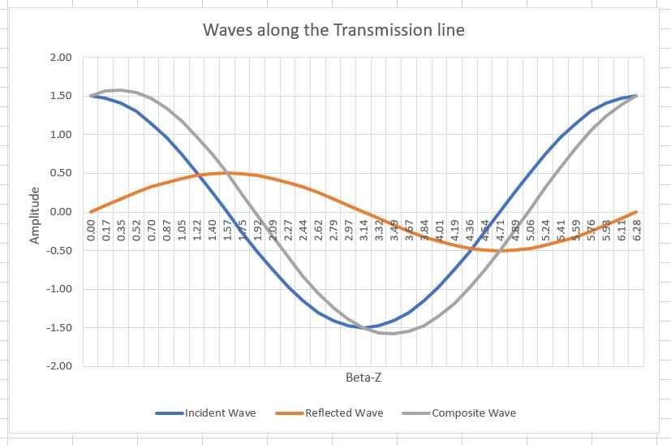
The 3 M’s of VSWR
Dave Casler, KE0OG, provided a very informative presentation to the Duck City Hamfest, NM, 2019. showing very interesting animation of the voltage standing wave phenomena:
https://youtu.be/BpIQH6PgpeA
Ask Dave #221

Slide 14
The 3 M’s of VSWR
From a purely mathematical point of view, the incident and reflected voltage waves can be represented using our phaser notation. Consider the 3:1 mismatch described in Casler’s presentation. ρ= .5:
$V_{inc}=V_{0}e^{(jωt−βz)}$ and $V_{ref}={ρV}_{0}e^{(jωt+βz)}$ (4)
where ρ =.5 in this case
where ω = 2πf, f = frequency, t = time, z = length along the transmission line
Using Euler’s Theorem, we can convert V_{inc} + V_{ref} wave phasers, to the sum of sines and cosines:
$e^{jα}=\cos{α+j\sin{α}}$. (5)

Slide 15
The 3 M’s of VSWR
Using only the real parts of each wave, we can redefine the composite voltage waves as:
V=V₀cos(ωt-βz) + .5V₀cos(ωt+βz) (6)
Using the sum - difference trigonometric expansion for each term yields:
V = V₀cos(ωt)cos(βz)+ V₀sin(ωt)sin(βz) + .5V₀cos(ωt) cos(βz)- .5V₀ sin(ωt) sin(βz) (7)
Combining like terms:
V = 1.5V₀cos(ωt) cos(βz) + 0.5V₀sin(ωt) sin(βz) (8)
This is the mathematical expression for a traveling standing wave
(Sorry for the rigor)

Slide 16
The 3 M’s of VSWR
This composite wave is not “standing”, contrary to popular belief.
Shown here in Casler’s slide, at maximum amplitude, for the composite wave (in light blue), under a 3:1 mismatch.

Slide 17
The 3 M’s of VSWR
Conclusions:
VSWR represents a “standing wave” only when the reflection coefficient ρ= +/-1, and that problems with reflections in a transmission line can be quite complex.
High VSWR can lead to high power loss in the cable. The higher the VSWR, the higher the reflection coefficient. This leads to overheating.
VSWR is the measure of how much RF voltage is reaching the antenna from the radio (ie: how much is being radiated).

Slide 18
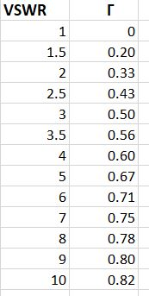
The 3 M’s of VSWR
Example:
If the characteristic impedance of a coaxial line is 50Ω, and the load impedance of the antenna is 400Ω at a particular frequency, the reflection coefficient is .778, ρ $=\frac{Z_{L}−Z_{c}}{Z_{L}+Z_{C}}$ resulting
in a VSWR of 8:1, $VSWR=\frac{1+ρ}{1−ρ}$
This means that 78% of the power delivered by the radio is being reflected back to the radio, resulting in potential damage to the set and overheating the cable. That’s bad!, requiring a tuner or other impedance matching device.

Slide 19
The 3 M’s of VSWR
Misconceptions:
Reflections in a transmission line does produce “standing waves”
Standing waves only occur when the reflection coefficient is one.
VSWR is associated with antenna performance.
Corrections to the antenna such as mechanical lengthening or shortening of elements can alter antenna impedance, improve VSWR and maximize RF radiated power
A SWR meter is not a good diagnostic tool.
An SWR meter, when properly placed will measure the ratio of the forward power to the reflected power in the transmission line.

Slide 20
The 3 M’s of VSWR
Misconceptions cont.
High VSWR is not necessarily bad.
High VSWR is always bad! Newer transceivers can handle a 3:1 mismatch without much problem, but anything higher than that can cause damage to the radio. Mismatches anywhere in the transmission line (ie: adapters, connectors) should be eliminated at all costs
Published antenna SWR data is a measure of antenna performance (ie: radiation pattern).
An antenna with a high VSWR simply will have trouble loading the RF energy into it.

Slide 21
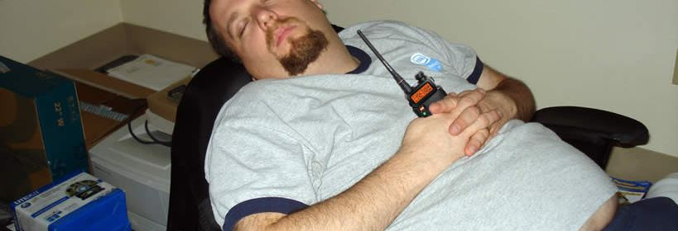
The 3 M’s of VSWR
I hope this presentation was not too tedious. But to really understand the phenomenon of standing waves, I needed to delve into the mathematics and physics of the situation.
Thank you for your attention.

Slide 22
The 3 M’s of VSWR
Citations:
Gasler, David, KE0OG, “Fun with SWR”, A Presentation given at the Duke City Hamfest, Albuerque, NM, 21 September, 2019
University of Colorado, PhET Interactive Simulation, Wave on a String 1.1.24, Ariel Paul (lead), 2018

